Slide 1
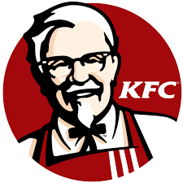
KFC Data Analysis
Using SQL

Slide 2
About KFC
KFC (Kentucky Fried Chicken) is one of the most popular fast-food chains in India, known for its signature fried chicken seasoned with a secret blend of 11 herbs and spices.
It entered the Indian market in 1995 and is operated by Yum! Brands, which also owns Pizza Hut and Taco Bell. Over the years, KFC has expanded its footprint across India, with more than 600 outlets in over 150 cities.
The brand has adapted its menu to suit Indian tastes by offering a variety of vegetarian options like the Paneer Zinger and Veg Rice Bowl, along with spicier variants of its chicken products.
KFC India serves a wide customer base, including urban youth, working professionals, and families, through dine-in, takeaway, drive-thru, and home delivery services. It partners with major food delivery platforms like Swiggy and Zomato and also offers delivery through its own app.
With a focus on speed, taste, and affordability, KFC continues to be a strong competitor in India’s quick-service restaurant (QSR) market, constantly innovating and localizing its offerings to remain relevant and loved by Indian customers.

Slide 3
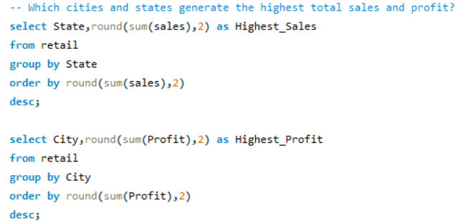
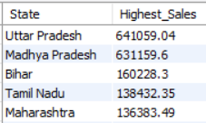
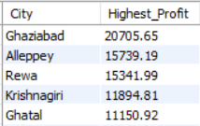
KFC Problem Statement
Which cities and states generate the highest total sales and
profit?

Slide 4
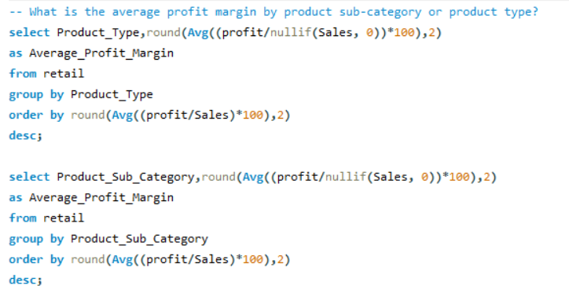

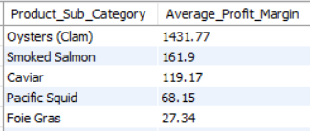
KFC Problem Statement
What is the average profit margin by product sub-category
or product type?

Slide 5
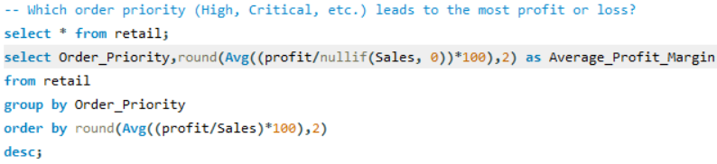
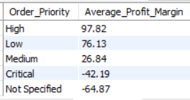
KFC Problem Statement
Which order priority (High, Critical, etc.) leads to the most
profit or loss?

Slide 6
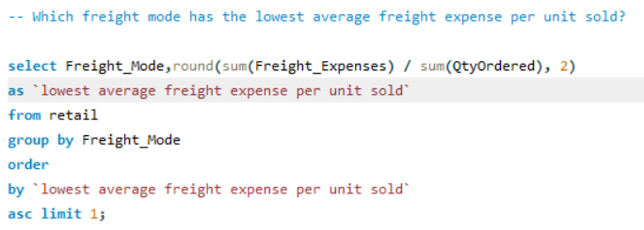

KFC Problem Statement
Which freight mode has the lowest average freight expense
per unit sold?

Slide 7
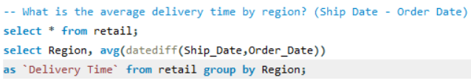
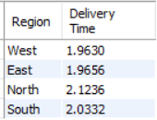
KFC Problem Statement
What is the average delivery time by region?
(Ship Date - Order Date)

Slide 8
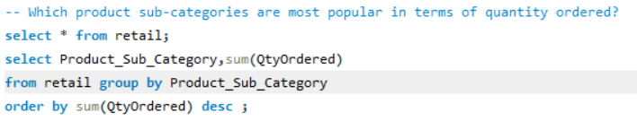
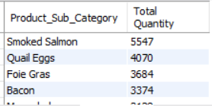
KFC Problem Statement
Which product sub-categories are most popular in terms of
quantity ordered?

Slide 9
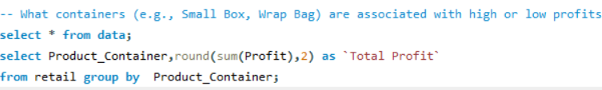
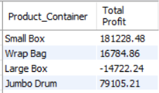
KFC Problem Statement
What containers (e.g., Small Box, Wrap Bag) are associated with high or low profits?

Slide 10
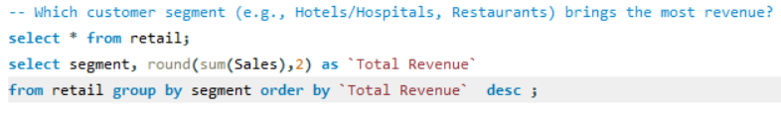
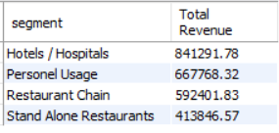
KFC Problem Statement
Which customer segment (e.g., Hotels/Hospitals,
Restaurants) brings the most revenue?

Slide 11
KFC Conclusion
Majority of sale and profit coming from specially in Uttar pradesh where Ghaziabad it’s top city which order highest Profit and Sales.
Profit Margin of the Processed Meat(112%) is higher than the all canned Foods(11%) and Preserved Food
(-9.87), where Preserved Food loss making Product.
Both Critical and Not-Specified Order Priority are loss making (it may contain loss generated by product). Other order priorities are performing well.
Delivery time which is the key Sales indicating indicator as less as Delivery time Customer Satisfaction increase with KFC product.
Smoked Salmon(5547 Unit) and Quail Eggs(4070) are leading Product sub-categories , while lowest unit sold are Wild berry.
When it comes Total Profit Large Box(-14722 Rs) low performing and small box(181228 Rs).
In Segment wise Revenue Hostel/Hospital(841291 Rs)
And personal Uses (667768 Rs) . KFC should promote the Hostel/Hospital and Personal uses. They have Big market share mostly managed by unorganized personals.

